Slide 1
Encoder
An encoder is a combinational circuit that converts binary information in the form of a 2^{N} input lines into N output lines, which represent N bit code for the input. For simple encoders, it is assumed that only one input line is active at a time. As an example, let’s consider Octal to Binary encoder. As shown in the following figure, an octal-to-binary encoder takes 8 input lines and generates 3 output lines.
Encoders are devices that receive a signal or data and translate it into code. This allows the original message to be sent to a specific destination and only be understood by the intended recipient. In other words, encoders make sure that communication is secure and confidential. Without them, businesses and governments would not be able to function properly.

Slide 2
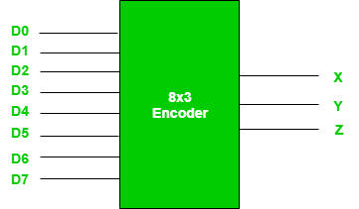

Slide 3
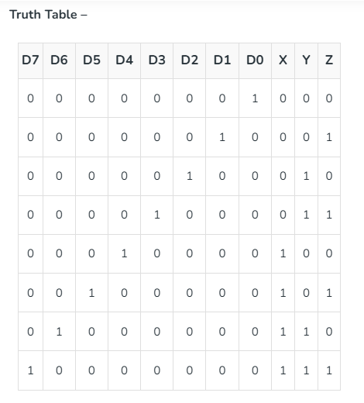

Slide 4
From the truth table, the output line Z is active when the input octal digit is 1, 3, 5 or 7. Similarly, Y is 1 when input octal digit is 2, 3, 6 or 7 and X is 1 for input octal digits 4, 5, 6 or 7. Hence, the Boolean functions would be:
X = D4 + D5 + D6 + D7
Y = D2 +D3 + D6 + D7
Z = D1 + D3 + D5 + D7
Hence, the encoder can be realized with OR gates as follows:

Slide 5
Decoder
A decoder does the opposite job of an encoder. It is a combinational circuit that converts n lines of input into 2 power n.
Let’s take an example of 3-to-8 line decoder.
Decoders are devices that take an input, such as a digital signal, and convert it into an output that can be understood by humans. This process is known as decoding. The output of a decoder can be in the form of audio, video, or text.

Slide 6
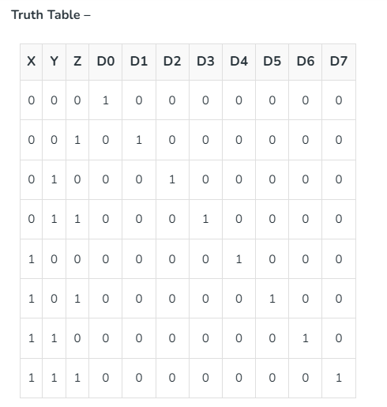

Slide 7
Implementation
D0 is high when X = 0, Y = 0 and Z = 0. Hence,
D0 = X’ Y’ Z’
Similarly ,
D1 = X’ Y’ Z
D2 = X’ Y Z’
D3 = X’ Y Z
D4 = X Y’ Z’
D5 = X Y’ Z
D6 = X Y Z’
D7 = X Y Z

Slide 8
